Slide 1
SOCIAL PROJECT
Facebook social network

Slide 2
Team Members
1- MOHAMMED MOSTAFA FATHY
2- BASEL AMGAD LABEEB
3 - MOHAMMED MOHEY ELDEEN SALAMA
4 - BESHOY ATEF TWFEECK SHAKER
5 - MICHEAL MELAD LABEEB

Slide 3
DATA SET
Description :
A social friendship network extracted from Facebook consisting of people (nodes) with edges representing friendship ties.
Link:
https://networkrepository.com/socfb-Haverford76.php
Project:
https://github.com/gezzzo/Social-final-project-

Slide 4
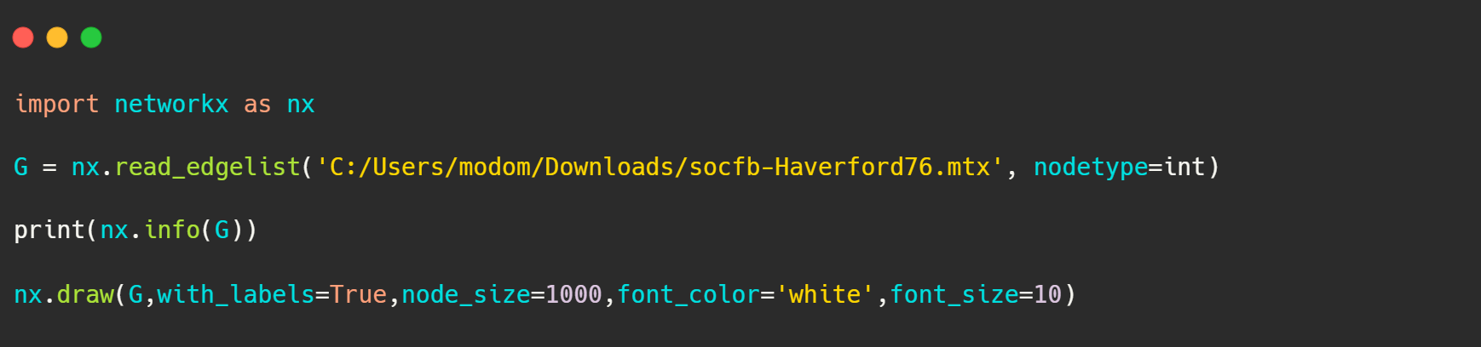
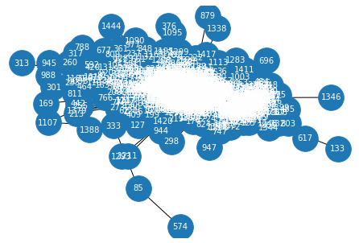
Draw Graph & Some Details
Name:
Type: Graph
Number of nodes: 1446
Number of edges: 59589
Average degree: 82.4191

Slide 5
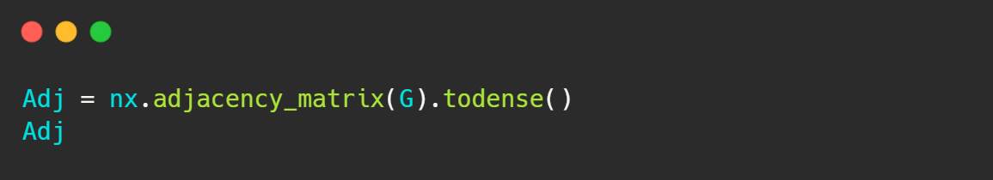
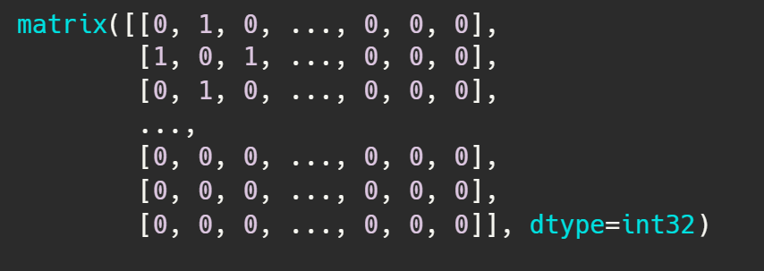
Adjacency matrix

Slide 6
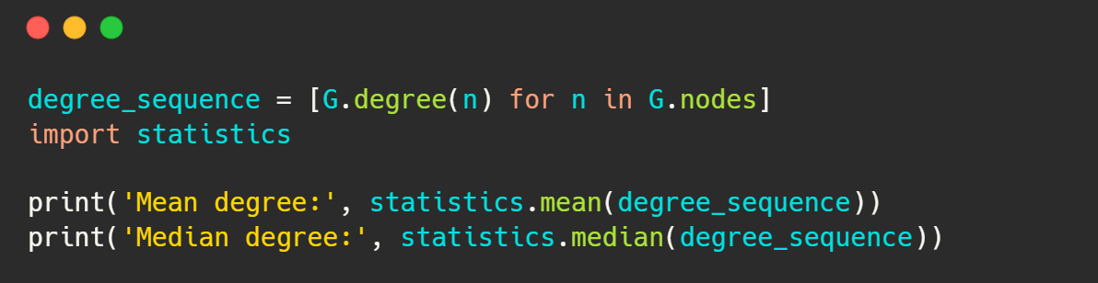
Mean & Median for nodes degree
Mean degree: 82.41908713692946
Median degree: 70.0

Slide 7
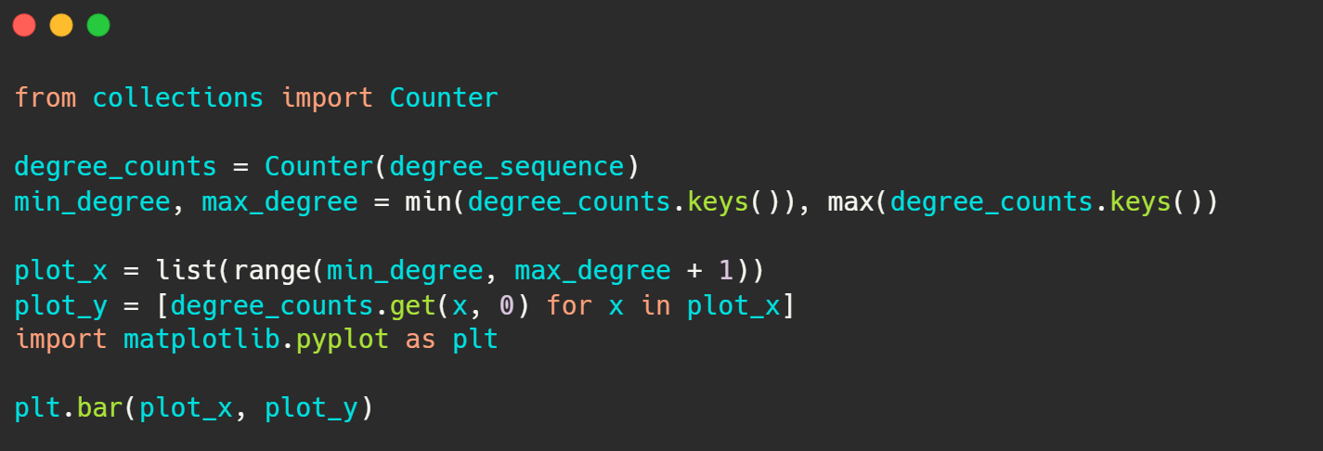
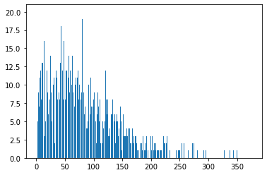
Plotting the distribution
<BarContainer object of 375 artists>

Slide 8
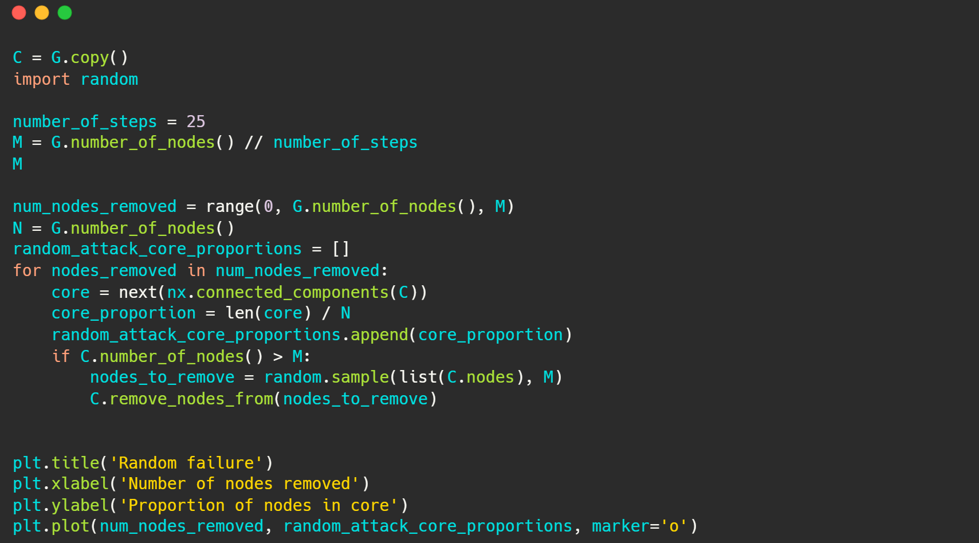
Random failure

Slide 9
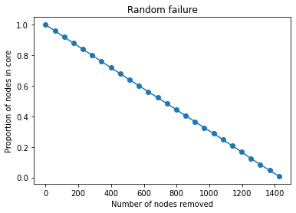
[<matplotlib.lines.Line2D at 0x21af4920eb0>]

Slide 10
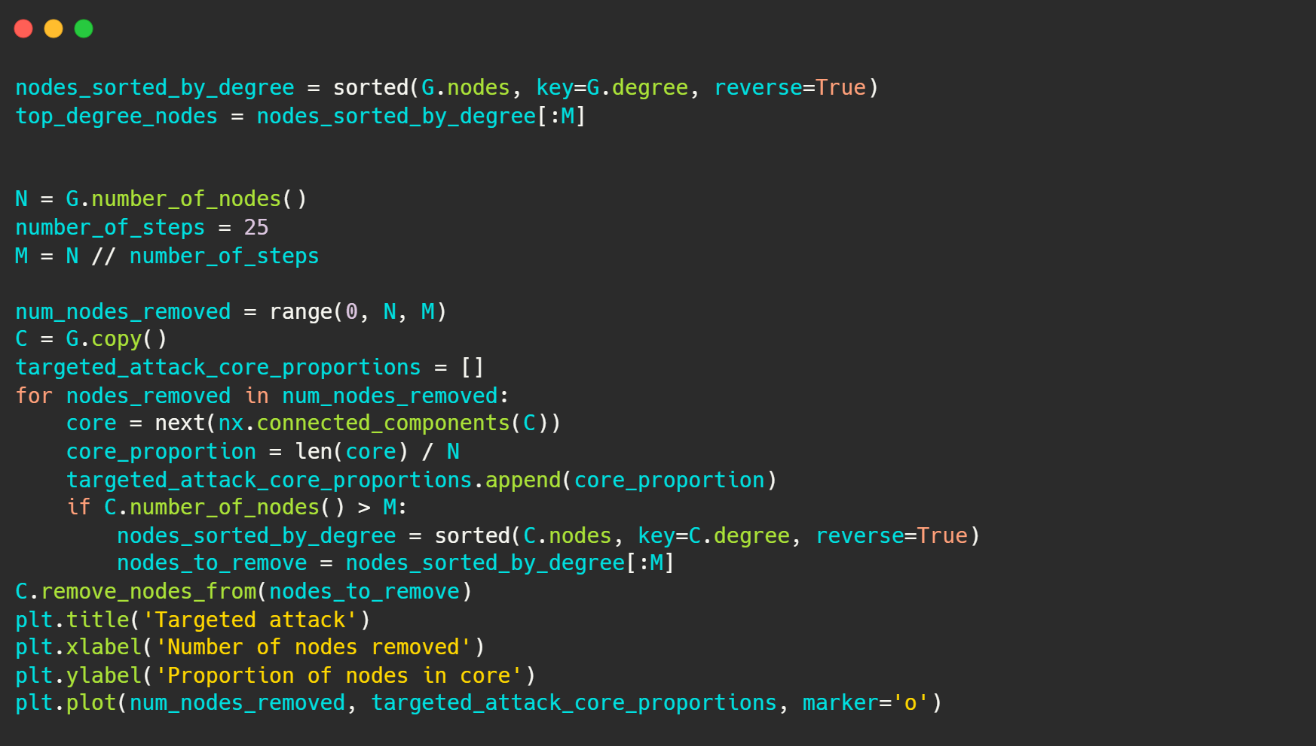
Targeted attack

Slide 11
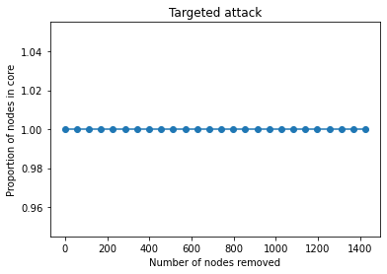
[<matplotlib.lines.Line2D at 0x21af3566460>]

Slide 12
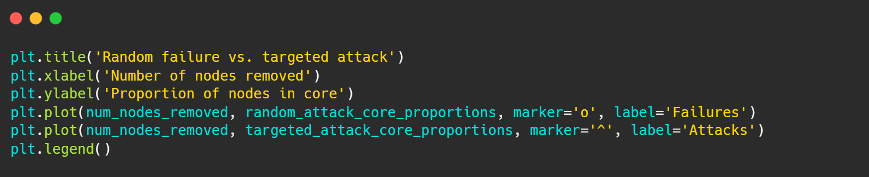
Random failure vs Targeted attack

Slide 13
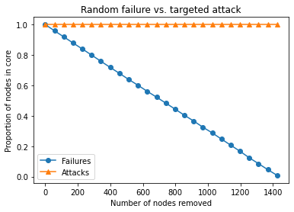
<matplotlib.legend.Legend at 0x21af3630ca0>

Slide 14
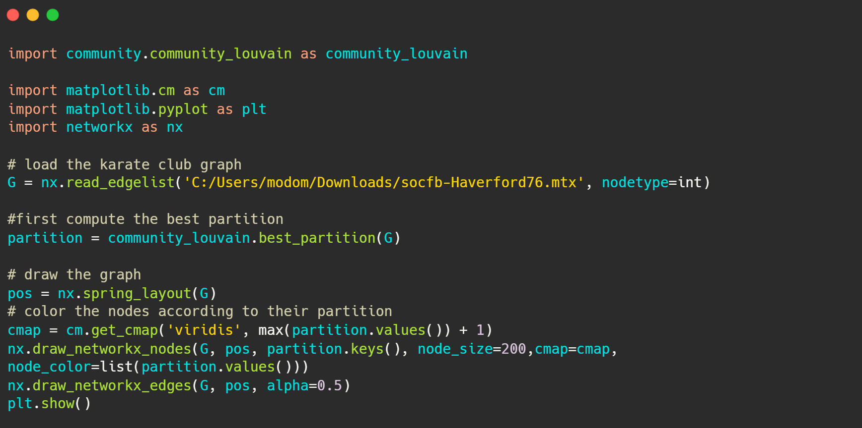
Community detection

Slide 15
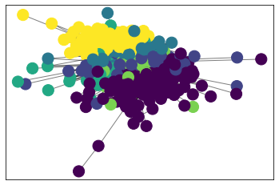

Slide 16
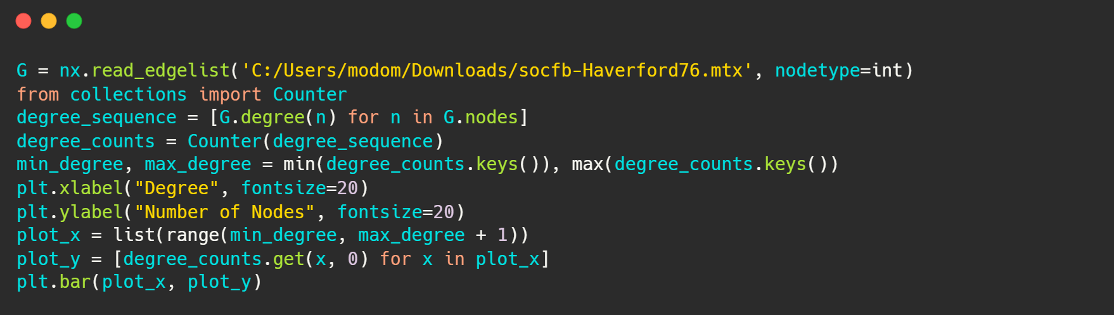
Degree & number of nodes

Slide 17
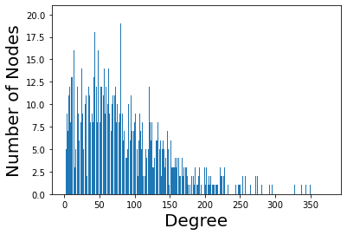
<BarContainer object of 375 artists>

Slide 18
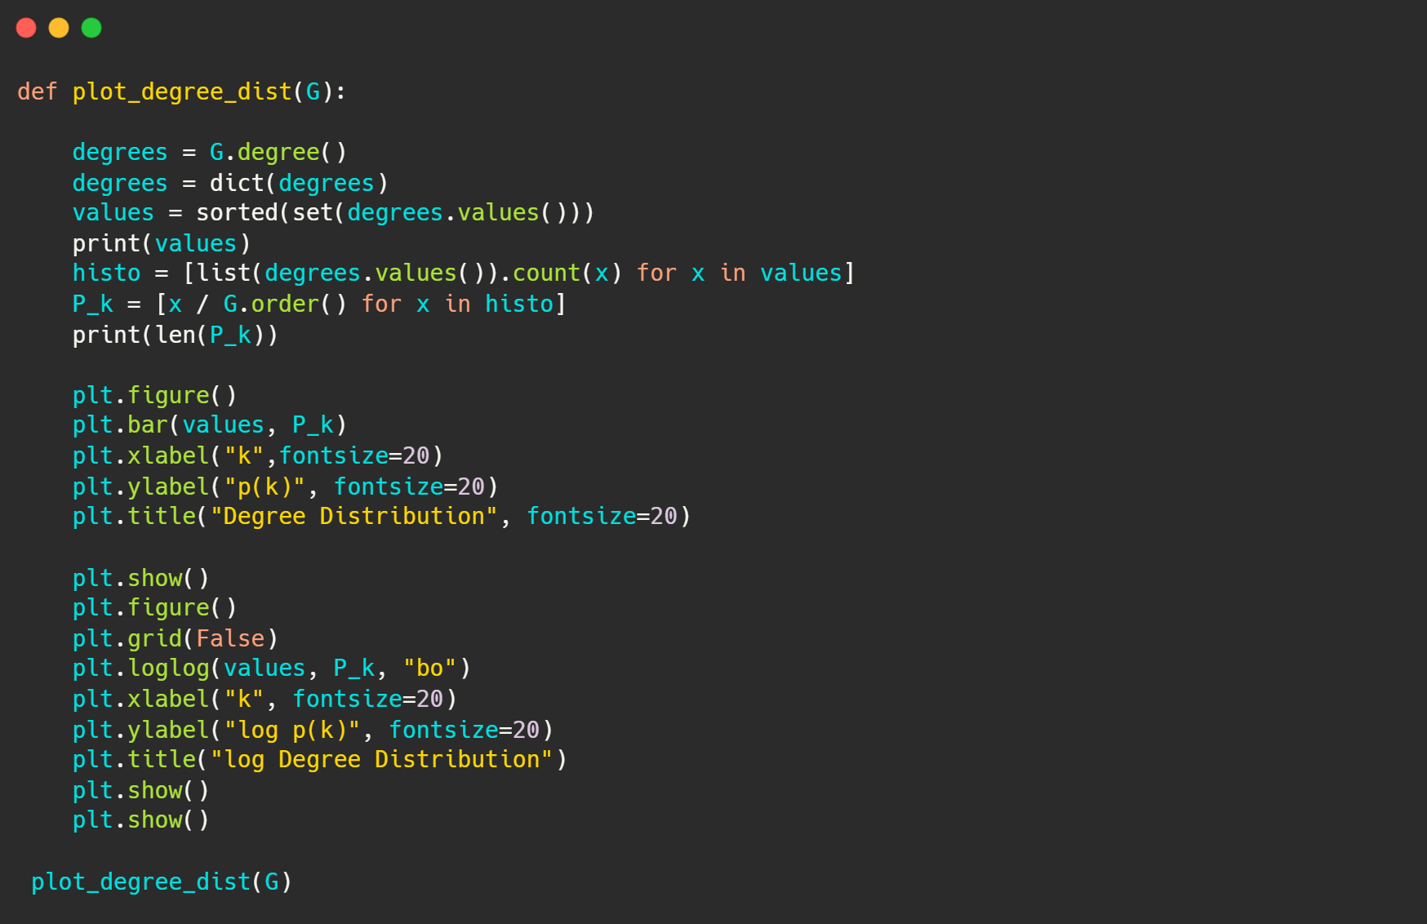
Degree Distribution

Slide 19
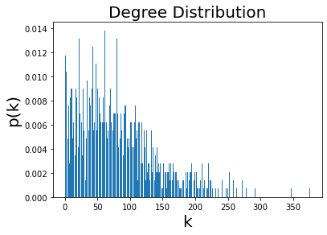
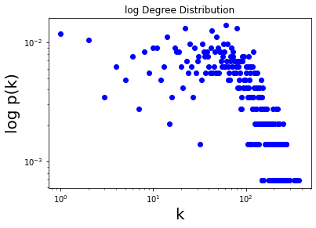
[1, 2, 3, 4, 5, 6, 7, 8, 9, 10, 11, 12, 13, 14, 15, 16, 17, 18, 19, 20, 21, 22, 23, 24, 25, 26, 27, 28, 29, 30, 31, 32, 33, 34, 35, 36, 37, 38, 39, 40, 41, 42, 43, 44, 45, 46, 47, 48, 49, 50, 51, 52, 53, 54, 55, 56, 57, 58, 59, 60, 61, 62, 63, 64, 65, 66, 67, 68, 69, 70, 71, 72, 73, 74, 75, 76, 77, 78, 79, 80, 81, 82, 83, 84, 85, 86, 87, 88, 89, 90, 91, 92, 93, 94, 95, 96, 97, 98, 99, 100, 101, 102, 103, 104, 105, 106, 107, 108, 109, 110, 111, 112, 113, 114, 115, 116, 117, 118, 119, 120, 121, 122, 123, 124, 125, 126, 127, 128, 129, 130, 131, 132, 133, 134, 135, 136, 137, 138, 139, 140, 141, 142, 143, 144, 145, 146, 147, 148, 149, 150, 151, 152, 153, 154, 155, 156, 157, 158, 159, 160, 161, 162, 163, 164, 165, 166, 167, 168, 169, 170, 171, 172, 173, 174, 175, 176, 177, 178, 179, 181, 182, 184, 185, 186, 187, 188, 189, 190, 191, 192, 193, 194, 195, 198, 199, 200, 201, 202, 203, 204, 205, 206, 207, 208, 210, 211, 212, 213, 214, 216, 217, 218, 219, 220, 222, 223, 224, 226, 227, 228, 231, 233, 235, 241, 244, 247, 248, 249, 250, 252, 254, 258, 263, 265, 272, 275, 278, 281, 292, 296, 328, 338, 344, 347, 350, 375]
246

Slide 20
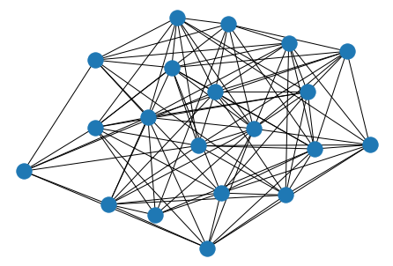
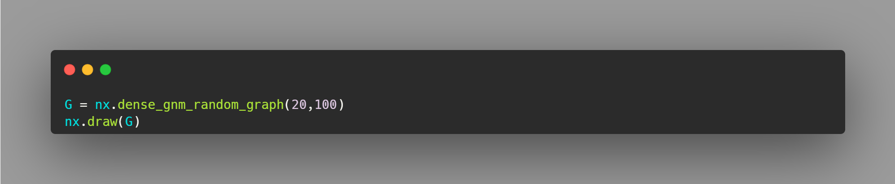
Simulation
random graph with initial state :

Slide 21
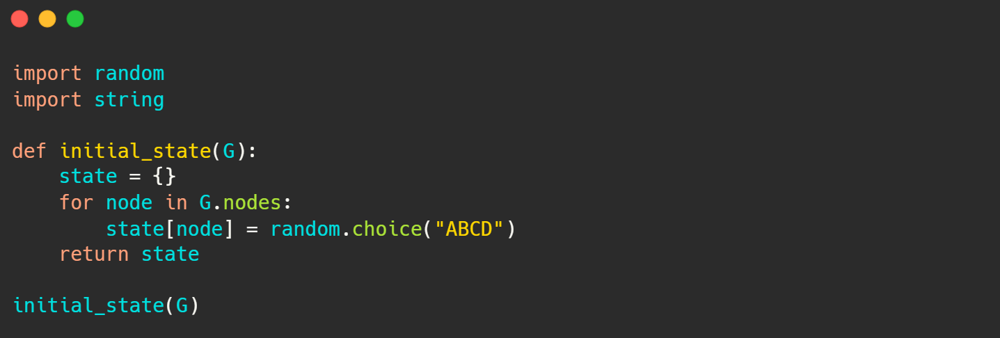
{0: 'C',
1: 'C',
2: 'A',
3: 'D',
4: 'A',
5: 'C',
6: 'C',
7: 'C',
8: 'C',
9: 'B',
10: 'A',
11: 'A',
12: 'C',
13: 'C',
14: 'B',
15: 'C',
16: 'B',
17: 'A',
18: 'A',
19: 'B'}

Slide 22
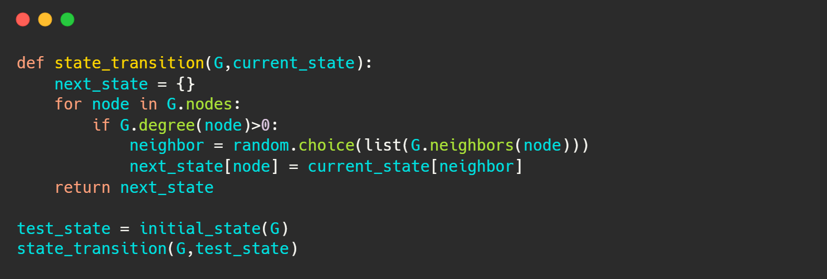
make a random state :
{0: 'C',
1: 'B',
2: 'B',
3: 'D',
4: 'D',
5: 'B',
6: 'C',
7: 'C',
8: 'B',
9: 'D',
10: 'C',
11: 'B',
12: 'C',
13: 'D',
14: 'B',
15: 'B',
16: 'C',
17: 'B',
18: 'B',
19: 'C'}

Slide 23
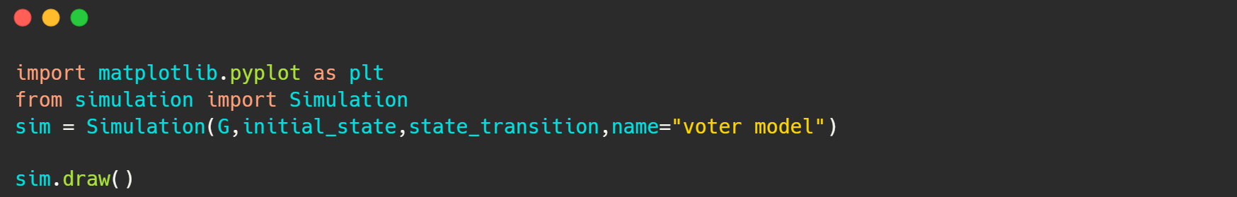
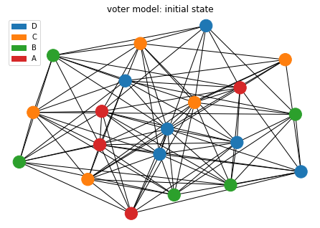
Run simulation & result after one step :

Slide 24
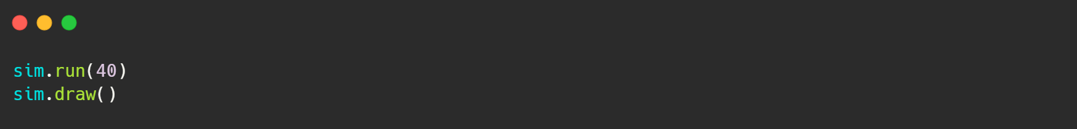
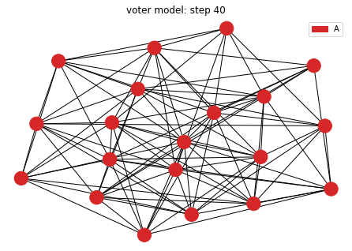
Simulation after 41 step:

Slide 25
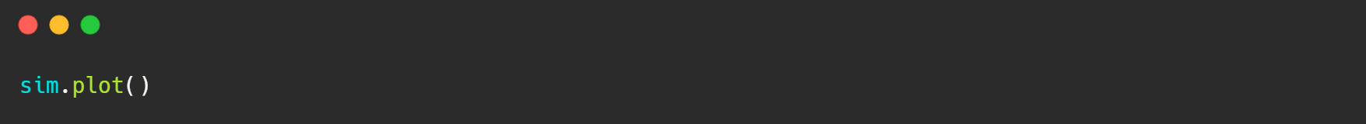
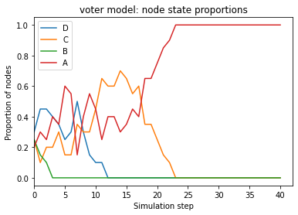
plot of simulation result in each step

